Slide 2
Blackjack
Pays 2 to 1

Slide 3
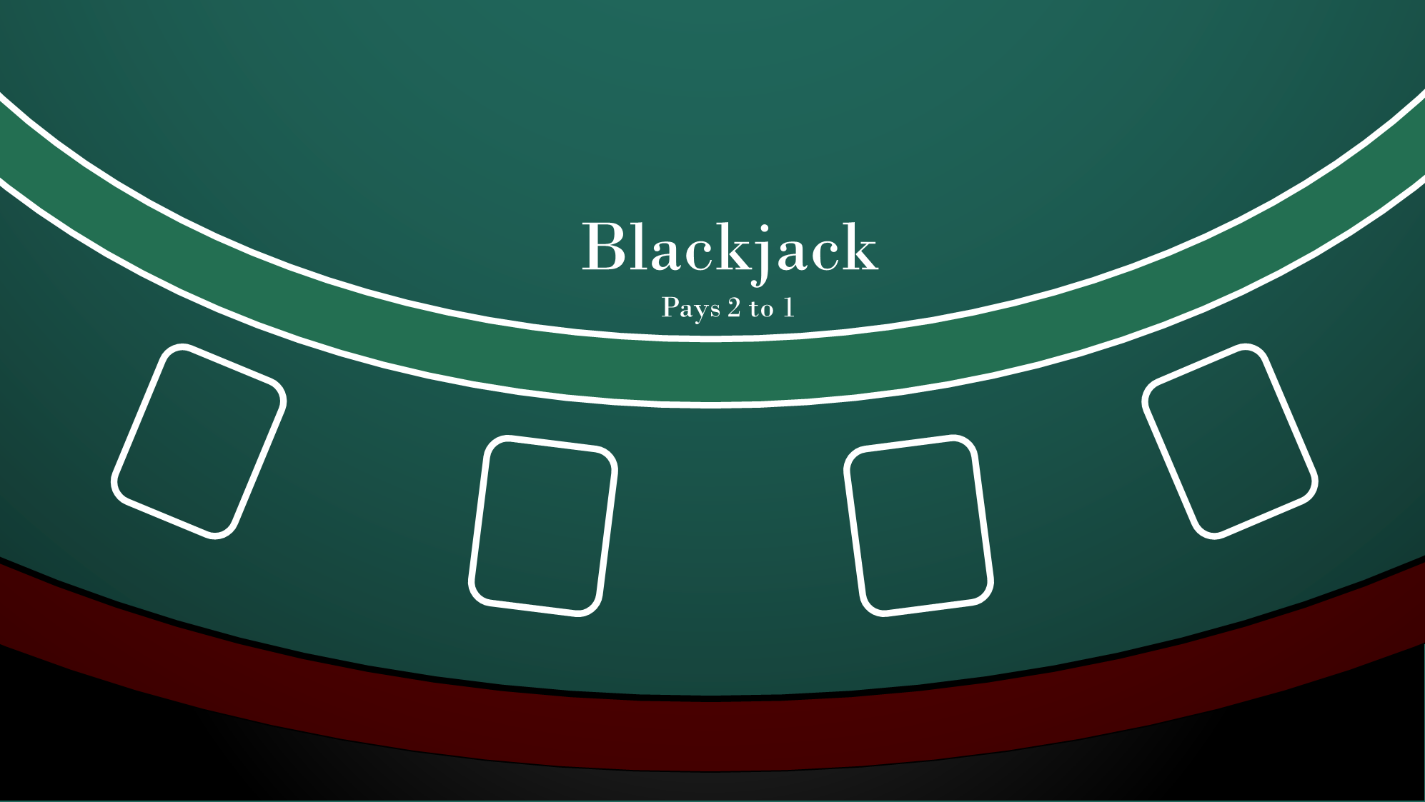

Slide 4
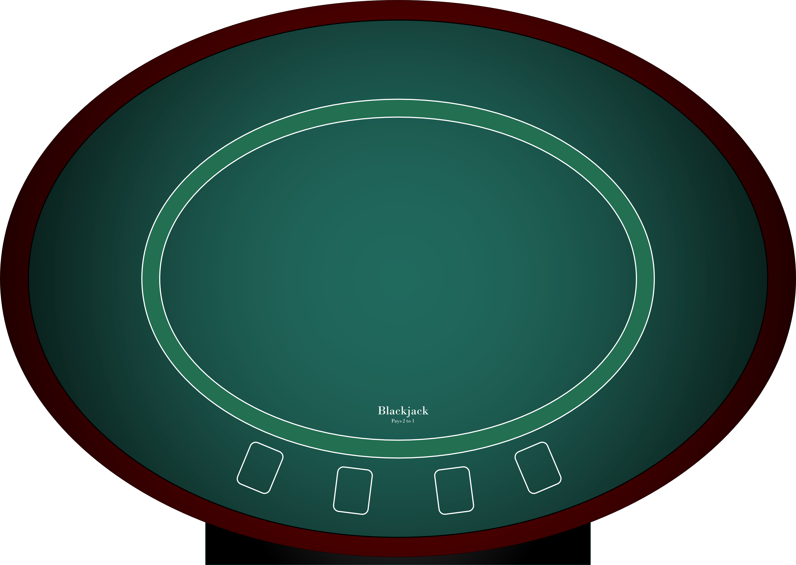

Slide 5
Blackjack
Pays 2 to 1

